Slide 1
Secure Communications
Fred Long

Slide 2
“Applied Cryptography” by Bruce Schneier, John Wiley & Sons Inc., 2e, 1996.
ISBN 0-471-12845-7
“The Code Book” by Simon Singh,
Fourth Estate Limited, 1999.
ISBN 1-85702-879-1
“Web Security & Commerce” by Simson Garfinkel with Gene Spafford,
O’Reilly & Associates, Inc., 1997.
ISBN 1-56592-269-7

Slide 3
Problems:
Confidentiality
Identification and Authentication
Data Integrity
Non-repudiation
Authorisation

Slide 4
Encryption
Encryption involves scrambling a message
plaintext
encryption
ciphertext
decryption
plaintext

Slide 5
There are just a few encryption/decryption algorithms
Therefore, the security of the encryption must depend on a parameter of the encryption, not just on the algorithm
This parameter is called the key

Slide 6
plaintext
encryption
ciphertext
key
key
decryption
plaintext

Slide 7
For example, a Caesar Cipher:
abcdefghi...rstuvwxyz
defghijkl...uvwxyzabc
So, fred -> iuhg
In this case, the key is 3

Slide 8
If the encryption and decryption keys are the same, we talk of symmetric key cryptography
Otherwise, we talk of asymmetric key cryptography, or public key cryptography
Practical asymmetric key cryptographic methods were first discovered in the UK in the early 1970s but kept secret; the first published methods appeared in the US in the late 1970s

Slide 9
The work in the UK was carried out at the Government Communications Headquarters (GCHQ) by:
  James Ellis
  Malcolm Williamson
  Clifford Cocks
The papers are now available on the web at: http://www.cesg.gov.uk/about/nsecret.htm

Slide 10
Symmetric Key Cryptography
Data Encryption Standard (DES); 1977, National Bureau of Standards (US); 56-bit fixed length key; very efficient, particularly if special hardware is used
Triple-DES (or DES-EDE) uses three applications of DES with two, independent DES keys; an effective key length of 112-bits

Slide 11
DES is a block cipher; it encrypts data in 64-bit blocks
The 64-bit block is split into left and right halves, then there are 16 rounds of identical operations:
L_{i} = R_{i-1}
R_{i} = L _{i-1} ⊕ f(R_{i-1} , K_{i})
where K_{i} is derived from the initial key by shifting the bits
The function f involves shifting, substituting and XORing bits

Slide 12
International Data Encryption Algorithm (IDEA); James Massey and Xuejia Lai, ETH Zurich, 1991; patented by the Swiss Ascom Tech AG; block cipher; fixed length 128-bit key; faster than triple-DES
RC2 and RC4; Ron Rivest, RSA Data Security Inc., early 1990s; variable length keys; claimed to be faster than IDEA
Blowfish; Bruce Schneier, 1994; public domain algorithm; variable length key; compact, simple and fast

Slide 13
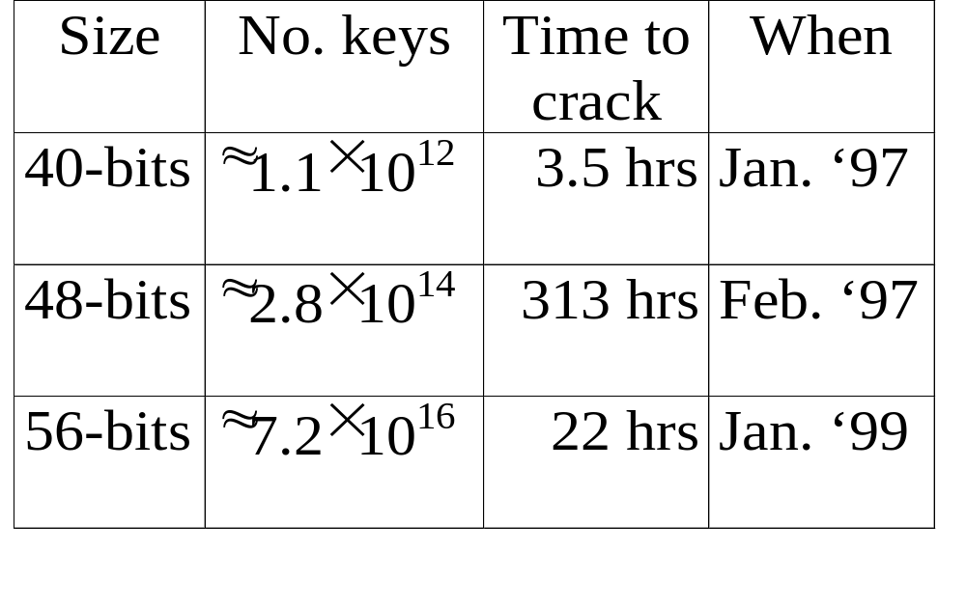
Key size does matter:

Slide 14
The big difficulty with symmetric key cryptography is the key management problem:
  Since the encryption and decryption keys are the same, they must be communicated securely
  Key changes must be synchronised between sender and recipient
So, symmetric key cryptography amounts to securely communicating a small piece of data (the key) in order to be able to then securely communicate large pieces of data (the messages)

Slide 15
Diffie-Hellman Key Exchange
In 1976, Whitfield Diffie and Martin Hellman published a key exchange protocol that overcame the key management problem
Suppose Alice and Bob want to set up a secure key
They find one-way functions A, B such that A(B(y))=B(A(y)) ∀y; then they agree on x; Alice sends Bob A(x); Bob sends Alice B(x) and they use the key k=A(B(x))=B(A(x))

Slide 16
In Diffie-Hellman, A(x) = xª mod p,
B(x) = x^{b} mod p, where p is a large prime number
So, k = A(B(x)) = (x^{b})ª mod p = x^{ba} mod p
= x^{ab} mod p = B(A(x))
The number a is known only to Alice,
the number b is known only to Bob,
the numbers p, x, A(x), B(x) can be made public
Calculating k given x involves finding the values a and b which means solving the discrete logarithm problem

Slide 17
Public Key Cryptography
plaintext
encryption
ciphertext
encryption
key
decryption
key
decryption
plaintext

Slide 18
The encryption and decryption keys are, clearly, related
However, given the encryption key, it is difficult to calculate the decryption key
For example, the encryption key can involve knowledge of the product of two very large prime numbers while the decryption key requires knowledge of the two separate prime numbers (factorising large numbers is notoriously difficult)
So, the encryption key can be made public while the decryption key remains private

Slide 19
In RSA, we find two very large primes p, q and a positive integer e invertible modulo (p-1)(q-1) so, we can find d such that
de ≡ 1 (mod (p-1)(q-1) )
d can be found easily if we know p and q but not if we know only n = pq
The encryption key is the pair (n, e):
E(b) = residue of b^{e} modulo n
The decryption key is the pair (n, d):
D (a) = residue of a^{d} module n
D(E(b)) = b since b^{(p-1)(q-1)} ≡ 1 (mod n)

Slide 20
Note that public key encryption methods can work the other way round, i.e., a message encrypted with the private key can be decrypted with the public key
However, a message encrypted with the private key is not confidential, because anyone can access the public key
Nevertheless, we will see applications of this back-to-front use of public key encryption later

Slide 21
RSA, named after its inventors: Ronald Rivest, Adi Shamir, and Leonard Adleman, 1978; much more computationally intensive than symmetric key algorithms (e.g., RSA is 100 times slower than DES in software, up to 1000 times slower in hardware)
ElGamal; El Gamal, 1985; depends on an arithmetic algorithm different from that of RSA (the so-called discrete logarithm problem)
Elliptic curve cryptosystems; proposed by Koblitz and Miller (independently) in 1985; more efficient than RSA

Slide 22
One-Way Hashing
A hash function, H(M), takes an arbitrary length message M and produces a fixed length hash value h = H(M).
A one-way (or secure) hash function has the properties that:
  given h, it is difficult to calculate M
  given M, it is difficult to find another M’ such that H(M) = H(M’)

Slide 23
One-way hash functions are used to secure passwords; the hash of the password is stored, not the password itself
They also play a role in secure communications
MD2, MD4, MD5; these are message digest methods devised by Ron Rivest; they produce 128-bit hashes
Secure Hash Algorithm (SHA); developed by the National Institute of Standards and Technology and the National Security Agency in the US; produces a 160-bit hash

Slide 24
Confidentiality
Clearly, any encryption method can guarantee confidentiality
The key management problem can be overcome by using either Diffie-Hellman key exchange or a public key encryption method

Slide 25
Identification and Authentication
If someone encrypts a message (almost any message) with their private key then anyone else can be sure of the originator of the message, because only they have access to their private key
Hence, this back-to-front use of public key encryption can be used to establish identification

Slide 26
A service wishing to be certain that it is communicating with who it thinks it is can send the communicating party a random message and ask the party to return it encrypted with the party’s private key
If the returned message successfully decrypts with the communicating party’s public key then the service can be sure that the party is genuine
Hence, back-to-front public key encryption also leads to authentication

Slide 27
Data Integrity
It is often necessary to ensure that data has not been corrupted or modified during transmission over a network
This can be done by generating a hash of the original data and comparing a hash of the received data with the original hash
For security, a secure hash can be used and the original hash sent encrypted by the sender’s private key

Slide 28
Non-repudiation
If a message is “signed” with a secure hash encrypted using the sender’s private key then the sender cannot later claim that they did not send that message
Similarly, if the receiver returns a secure hash encrypted with their private key then they cannot later deny receiving the message

Slide 29
Authorisation
Authorisation is concerned with granting privileges depending on the identity of users and agents
So, this is clearly related to identification and authentication
But, if we receive a public key, how can we be sure it is from who it claims to be from?

Slide 30
Digital Certificates
Possession of a public key ensures only that the holder of the corresponding private key can decrypt the message
It does not guarantee the identity of the private key holder
Trust is achieved only after the public key is bound to a known identity
A digital certificate binds the identity of an entity (person or system) to their public key

Slide 31
A digital certificate is, essentially, the entity’s public key (plus, possibly, other information) signed with the private key of the known authority (called the certificate authority or CA)
Common types of certificate:
  personal certificates
    identifies an individual for authorisation, signing, ...
  site certificate
    identifies a system for, e.g., secure communication
  code-signing certificate
    identifies the developer to guarantee authenticity, ...
  authority certificate
    identifies the CA, used to sign other certificates

Slide 32
Certificate Chains
Essentially, a certificate contains the subject’s and the issuer’s data — the subject is chained to the issuer
Why should one trust the CA who signs a certificate?
If necessary, the subject–issuer chain can be continued

Slide 33
subject: Fred Long
issuer: Dept. Comp. Sci.
subject: Dept. Comp. Sci.
issuer: UWA
subject: UWA
issuer: HEFCW
subject: HEFCW
issuer: Welsh Assembly
subject: Welsh Assembly
issuer: UK Government
subject: UK Government
issuer: UK Government

Slide 34
There are international standards for digital certificates, e.g., X.509
Example CAs:
  VeriSign: http://www.verisign.com/
  Thawte: http://www.thawte.com/
  (although Thawte has been taken over by VeriSign)
Certificates from VeriSign and Thawte are recognised by the main browsers
One can generate one’s own certificates using (e.g., Netscape’s signtool, MS’s certificate server, Java’s keytool) but these will not be recognised by the browsers

Slide 35
Secure Socket Layer (SSL)
SSL was developed by Netscape in 1994. The latest version is version 3.0.
SSL is a protocol that enables the client and server to agree on the cryptographic techniques they will use, authenticate each other, and then exchange a master key for use in subsequent communications

Slide 36
Transport Layer Security (TLS)
The Internet Engineering Task Force (IETF) is attempting to introduce an international standard, based on SSL 3.0, called Transport Layer Security (TLS)
TLS is similar to SSL 3.0, but has a slightly different cipher suite and uses the HMAC secure message digest instead of MD5
A Request for Comments on the TLS Protocol v 1.0 was issued in January 1999

Slide 37
Pretty Good Privacy (PGP)
PGP was developed by Philip Zimmermann in 1991 as an electronic-mail security program
PGP uses RSA for key exchange and digital signatures; MD5 for integrity checking; ZIP for compression; and IDEA for data encryption
PGP uses “rings of trust” instead of chains

Slide 38
Privacy Enhanced Mail (PEM)
PEM is another IETF standard
Again, it is really a protocol
PEM allows for
  Data encryption: DES
  Key management: DES or RSA
  Integrity checking: RSA/MD2 or RSA/MD5
  Digital signing: RSA/MD2 or RSA/MD5

